Slide 1
Cultural Dissemination: An Agent-Based Model with Social Influence and Extended Interaction Rules
Based on: Cultural Dissemination: An Agent-Based Model with Social Influence (JASSS 2021)
MOTIKI VENKATA SRIRAJ
SC25M062
M.TECH - DSP

Slide 2
Why Study Cultural Dissemination?
Cultural Spread
Ideas, opinions and cultural traits propagate through societies via interactions
Social Influence
Neighborhood context shapes whether change occurs or not
Real-World Parallels
Polarization, echo chambers, stubbornness.

Slide 3
Background: The Axelrod Model (1997)
Two principles: Homophily + Assimilation → Absorbing states
Homophily: similar neighbors interact
Assimilation: when agents interact, one adopts the other's trait on a random unshared feature
Absorbing state: no further interaction possible between agents — the system "freezes"

Slide 4
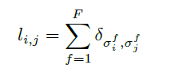
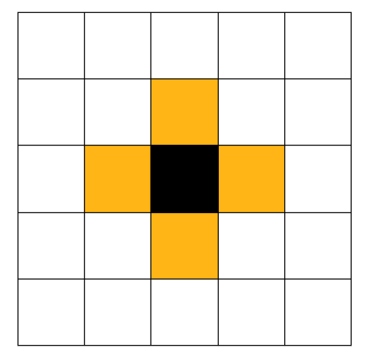

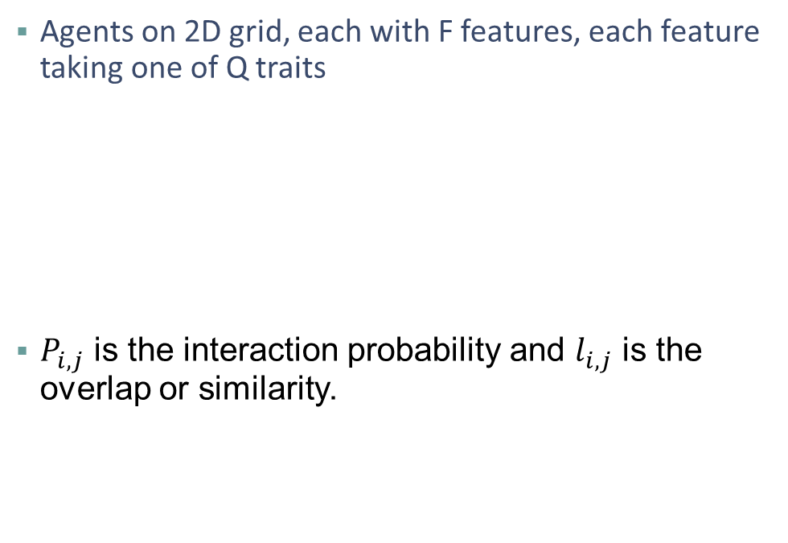
The Axelrod Model
Agents on 2D grid, each with F features, each feature taking one of Q traits
$P_{i,j}$ is the interaction probability and $l_{i,j}$ is the overlap or similarity.
Von Neumann Neighborhood

Slide 5
Limitations of the Axelrod Model
Pairwise Interaction Only
No Neighborhood Influence
Mono-culture as grid size increases
One-to-one communication
Heterogeneity also depends on ratio of Q/F

Slide 6
Results

Slide 7
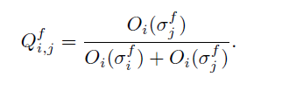

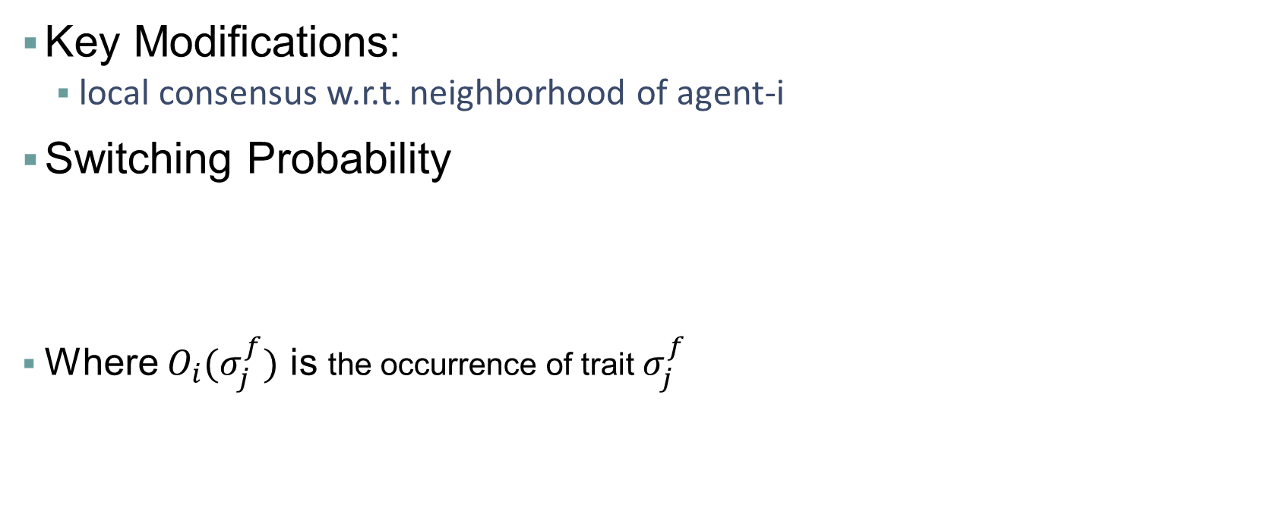
Social Influence Model (Baseline)
Key Modifications:
local consensus w.r.t. neighborhood of agent-i
Switching Probability
Where $O_{i}(σ_{j}^{f})$ is the occurrence of trait $σ_{j}^{f}$

Slide 8
Algorithm
Select agent-i and one of its neighbor
Interaction Probability
$$P_{i,j}$$
Interaction Probability
𝑃_(𝑖,𝑗)
Check Interaction
Pick random feature F
Survey agent-i Neighborhood
$O_{i}(σ_{j}^{f})$ and $O_{i}(σ_{i}^{f})$
Survey agent-i Neighborhood
𝑂_𝑖 (𝜎_𝑗^𝑓) and 𝑂_𝑖 (𝜎_𝑖^𝑓)
Switching Probability
$$Q_{i,j}^{f}$$
Switching Probability
𝑄_(𝑖,𝑗)^𝑓
Assimilation
Agent-i adopts $σ_{j}^{f}$
Assimilation
Agent-i adopts 𝜎_𝑗^𝑓

Slide 9
Experimental Setup
Simulation Parameters:
Grid Size - [5, 10, 15, 20, 25,30]
Features (F) – 5
Traits per Feature (Q) – 10
Repetitions - Von Neumann
Termination - Absorbing state reached
Metrics Tracked:
Number of frozen zones
Largest zone fraction
Events to absorption
Interactions to absorption
Zone size distribution

Slide 10
Replication Results
Social Influence vs Axelrod – 30x30 grid, F=5, Q=10, 100 runs
Metric | Axelrod Model | Social Influence Model (Paper) | Social Influence Model (Simulations)
Avg frozen zones | 1.02 | 8.0 | 2.24
Total events to absorption | 7.9M | 23.5M | 4.63M
Total interactions to absorption | 1.8M | 375K | 280K
Single-agent zones per run | ~0.2 | ~3.8 | ~3
SI Model needs ~6x fewer interactions to absorption state | Assumption: SI model avoids monoculture entirely

Slide 11
Observations
Axelrod Model
SI Model
As the grid size increases the number of frozen zones decreases in Axelrod model while it increases in SI model.

Slide 12
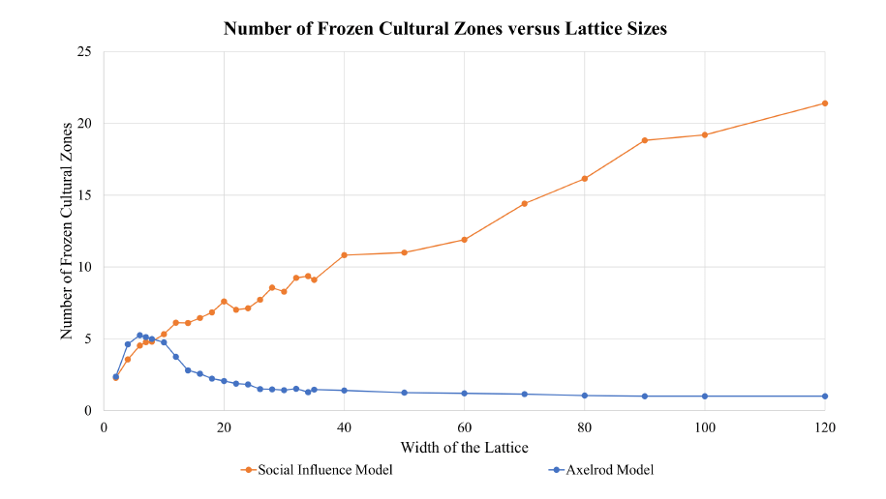
Heterogeneity and lattice size
100 trials were conducted for each lattice width from 2 to 22;
50 trials each for lattice widths from 24 to 40;
20 trials for each width from 50 to 100;
10 trials for lattice width 120.
All trials were conducted with F = 5 features and Q = 10 trait values, until an absorbing state was reached.

Slide 13
Influencing Factors
Dominant Regions Effect:
Favoring homogeneity as larger cultural regions absorb smaller cultural regions during interactions
Multiplicity Effect:
Favoring heterogeneity as lattice size is increased
Zone Robustness Effect:
SI hardens zone boundaries — agents surrounded by same-trait neighbors are much less likely to switch

Slide 14
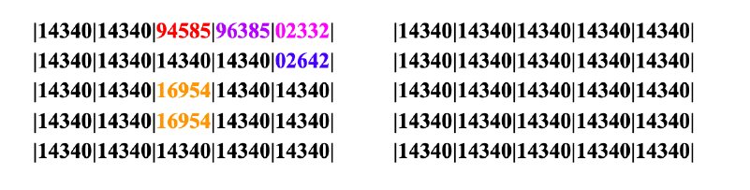
Behavior Analysis
Simulations resulted in a mono-culture in 75% of the runs for the Axelrod Model and in 90% of the runs for the Social Influence Model.

Slide 15
Highlights
Assumption: Combination of zone robustness with multiplicity effect will lead to more diversity in SI Model.
Observations: Dominant regions effect is stronger in the SI model (mono-culture in 90% of test runs vs 75% for Axelrod) .
The more you care about what your neighbors think, the more diverse society becomes in the long run. The boundary dynamics between two competing cultural regions is modeled as a random walk. The probability that a region absorbs another scales directly with relative size.

Slide 16
Observations

Slide 17
Extension 1 – Modified Social Influence: Dual-Support Rule
What if agents-i consult both neighborhoods before deciding?

Slide 18
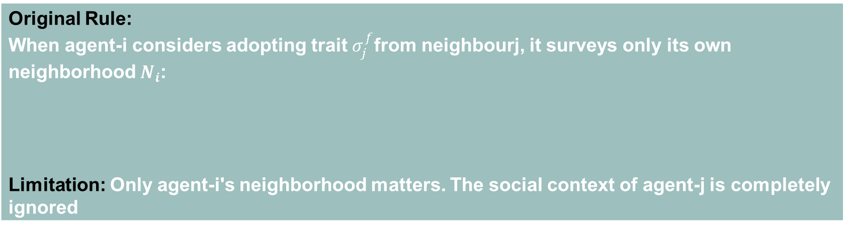
Inspiration
Original Rule: When agent-i considers adopting trait $σ_{j}^{f}$from neighbourj, it surveys only its own neighborhood $N_{i}$: Limitation: Only agent-i's neighborhood matters. The social context of agent-j is completely ignored
Real world insights: A single person can change your mind if their community strongly agrees Two-sided local consensus → more realistic social dynamics

Slide 19
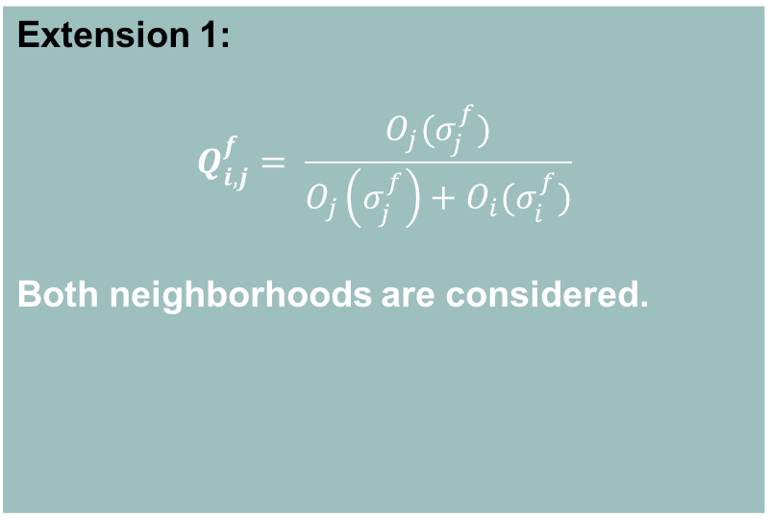
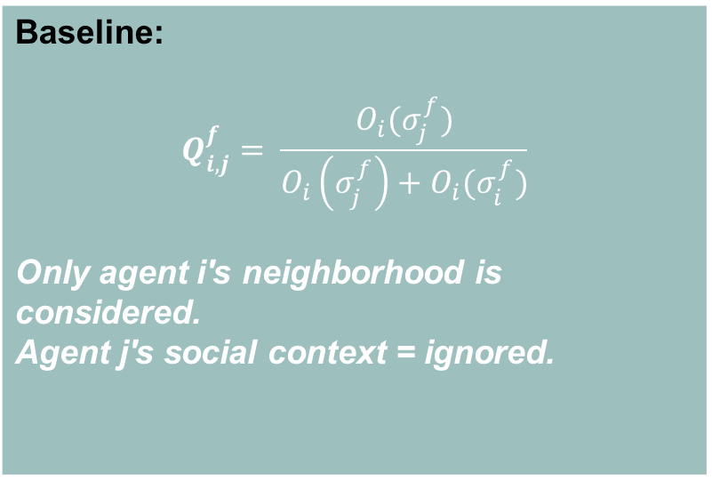
New Interaction Rule
Baseline: $$Q_{i, j}^{f}= \frac{O_{i}(σ_{j}^{f})}{O_{i}\left(σ_{j}^{f}\right)+O_{i}(σ_{i}^{f})}$$ Only agent i's neighborhood is considered. Agent j's social context = ignored.
Extension 1: $$Q_{i, j}^{f}= \frac{O_{j}(σ_{j}^{f})}{O_{j}\left(σ_{j}^{f}\right)+O_{i}(σ_{i}^{f})}$$ Both neighborhoods are considered.

Slide 20
Effective Global Influence
Even though the model is local this can emerge when:
Networks are highly connected
Many overlapping neighborhoods leads to global influence
Two-sided local consensus, more realistic social dynamics
Echo Chamber Effect High Support groups lead to stable competing regions | Group Reinforcement Strongly held groups resonate each other

Slide 21
Algorithm: Modified SI Model
Select agent-i and one of its neighbor
Interaction Probability
$$P_{i,j}$$
Interaction Probability
𝑃_(𝑖,𝑗)
Check Interaction
Pick random feature F
Survey agent-i’s Neighborhood
$O_{i}(σ_{i}^{f})$
Survey agent-i’s Neighborhood
𝑂_𝑖 (𝜎_𝑖^𝑓)
Survey agent-j’s Neighborhood
$O_{j}(σ_{j}^{f})$
Survey agent-j’s Neighborhood
𝑂_𝑗 (𝜎_𝑗^𝑓)
Compute Switching Probability and Assimilate

Slide 22
Experimental Setup: Extension 1
Simulation Parameters:
Grid Size - [5, 10, 15, 20, 25,30]
Features (F) – 5
Traits per Feature (Q) – 10
Repetitions - Von Neumann
Termination - Absorbing state reached
Metrics Tracked:
Number of frozen zones
Largest zone fraction
Events to absorption
Interactions to absorption
Zone size distribution

Slide 23
Results: Modified SI Model
Metric | Social Influence Model (Simulations) | Modified SI
Avg frozen zones | 2.24 | 2.58
Total events to absorption | 4.63M | 3.9M
Total interactions to absorption | 280K | 275K
Single-agent zones per run | ~3 | ~4

Slide 24
Results: Extension-1
SI Model
Modified SI Model

Slide 25
Results: Extension-1
SI Model
Modified SI Model

Slide 26
Observations
The first plot tracks both models identically. But in second plot, Modified SI model maintains a presence of cultures at much higher interaction counts compared to the standard SI Model.

Slide 27
Extension 2 – Stubborn Agents
What if a percentage of agents are unwilling to interact?

Slide 28
Extension-2: Stubborn Agents
Definition: A stubborn agent has its switching probability Q overridden to 0 — it participates in interactions but never changes its trait values. A fraction p of agents are designated stubborn at initialization.
Implementation Details
Stubborn agents are selected uniformly at random time t=0
They participate normally in interaction selection (events counted)
When selected as agent-i: Q = 0 – no trait change
When selected as neighbor-j can influence agent-i normally
Stubborn fraction varies from 0 to 40%

Slide 29
Expected Effects
Stubborn agents create indestructible single-agent zones
Propagation barriers – chains of stubborn agents can permanently separate cultural regions
Slow convergence – or possibly no convergence in some configurations
Increased fragmentation – more small frozen zones anchored to stubborn structures

Slide 30
Results: Stubborn Agents

Slide 31
Results: Stubborn Agents

Slide 32
Results: Stubborn Agents
epsilon | Q | F | alpha | stability-window | stubborn-fraction | grid-size | interaction-rate | number-of-regions | unique-cultures | active-links | event-count | interaction-count | largest-region-fraction
0.001 | 10 | 5 | 0 | 10 | 0.1 | 30 | 0.0949 | 303 | 270 | 779 | 1797000 | 170726 | 0.0668
0.001 | 10 | 5 | 0 | 10 | 0.2 | 30 | 0.08475 | 430 | 407 | 854 | 1748000 | 148416 | 0.0297
0.001 | 10 | 5 | 0 | 10 | 0.3 | 30 | 0.071 | 503 | 488 | 826 | 1566000 | 111289 | 0.0204
0.001 | 10 | 5 | 0 | 10 | 0.4 | 30 | 0.0571 | 571 | 561 | 795 | 1442000 | 82482 | 0.0144
The diversity of society is directly proportional to the ration of stubborn agents.

Slide 33
Comparative Observations
Metric | Axelrod Model | Social Influence Model (Simulations) | Modified SI
Avg frozen zones | 1.02 | 2.24 | 2.58
Total events to absorption | 7.9M | 4.63M | 3.9M
Total interactions to absorption | 1.8M | 280K | 275K
Single-agent zones per run | ~0.2 | ~3 | ~4

Slide 34
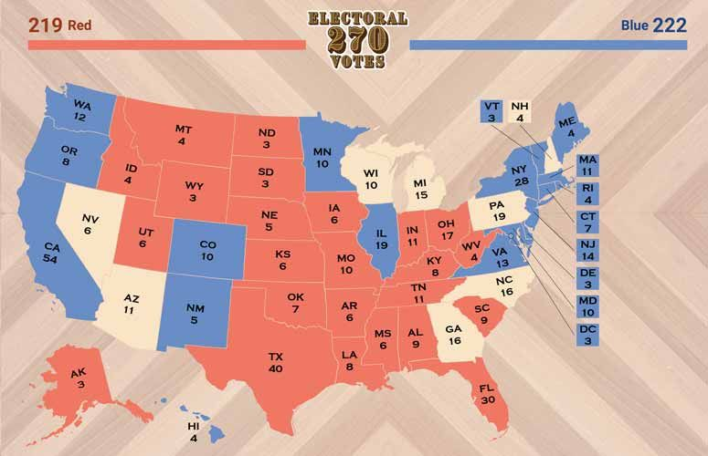
Real-World Implications and Parallels
Political polarization
Red States
Blue States
Swing States
Political polarization can be associated with SI logic. Local reinforcement of opinions.
Also some form of stubbornness is included.

Slide 35

Real-World Implications and Parallels
Global Trend - Labubu Doll
Many overlapping neighborhoods leads to global influence
Spread of information similar to ripples
The Modified SI model describes how the local changes results in global cascades.

Slide 36
Real-World Implications and Parallels
A study compiled by the Wall Street Journal found that “people living near lottery winners are significantly more likely to file for bankruptcy ” due to social pressure to "keep up with the Joneses”. (SI Model)
The 2007 study by Nicholas Christakis and James Fowler, published in the New England Journal of Medicine, analyzed data from the Framingham Heart Study to concluded that obesity spreads through social ties, with clusters of obese individuals extending up to three degrees of separation. (Modified SI Model)
Religious beliefs remain stable for centuries, even with globalization. (Multiple Models explains its effects)

Slide 37
Questions
Does extension 1 slow down convergence?
Does it produce more stable competing cultural regions?
Does fragmentation increase beyond baseline SI model?
How do we compare across Axelrod, SI model, Extension 1 and Extension 2?

Slide 38
Conclusions
Replicated Axelrod and Social Influence models, confirming heterogeneity amplification via neighborhood-based switching probability
Social Influence creates robust zones through a competition between dominant-regions effect and zone resistance to boundary infiltration
Extension 1 (Dual-Support) introduces group-level competing consensus — a novel mechanism explaining echo chambers and polarization
Extension2 (Stubborn Agents) increase fragmentation and can prevent convergence — modeling committed minorities in polarized systems
Insight: caring about your neighbors' opinions ultimately preserves diversity.
SI Model explain why minorities survive and diversity exists.

Slide 39
References
Nguyen, N., Chen, H., Jin, B., Quinn, W., Tyler, C., & Landsberg, A. (2021). Cultural Dissemination: An Agent-Based Model with Social Influence. Journal of Artificial Societies and Social Simulation, 24(4)5. DOI: 10.18564/jasss.4633
Axelrod, R. (1997). The dissemination of culture: A model with local convergence and global polarization. Journal of Conflict Resolution, 41(2), 203–226.
Hegselmann, R. & Krause, U. (2002). Opinion dynamics and bounded confidence. Journal of Artificial Societies and Social Simulation, 5(3), 2.
Model code: https://www.comses.net/codebases/dda2d2ac-0cf9-46f6-a213-e0a9a30378ed/releases/1.0.0/

